Slide 1
Lecture 12: Convexity

Slide 2
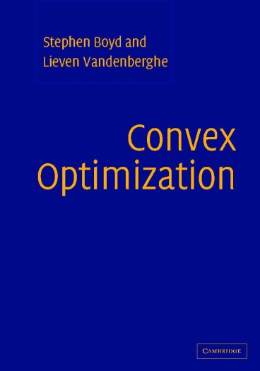
Textbook
http://www.stanford.edu/~boyd/cvxbook/

Slide 3
Convex set: definition
Definition: M is convex if
Definition: M is convex if
“convex combination”

Slide 4
Quiz

Slide 5
Examples of convex sets:
Empty set
Complete space
Halfspace
Affine set
Intersection of any number of convex sets
Polygon

Slide 6
Affine transform and convexity
Affine transform
f(S) is convex
f⁻¹(S) is convex

Slide 7
Norm balls
Norm ball:
Recall: the definition of the norm:

Slide 8
The set of positive semi-definite matrices
(A symmetric)
Is it convex? Why?

Slide 9
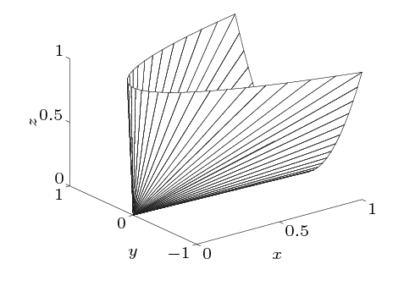
Geometry of PSD cone
Image from BV

Slide 10
A related example
The set of all ellipses containing given n points
Quadric equation:
What about the set of ellipses containing these three points?

Slide 11
The convex hull of M is….
The intersection of all convex sets containing the set M, or

Slide 12
Separating hyperplane
Theorem. if C and D are non-intersecting convex sets in R^{n}, then there exists a in R^{n} and b in R:
Could we require strict separability?
Notes:
Idea of the proof: find the closest points, find the midpoint, prove that the perpindicular is separating (use convexity)

Slide 13
Supporting hyperplane
Theorem:
Let C be a convex set.
Let p ∈ bd C
Then:
C
p
(this hyperplane is called supporting hyperplane to C at p)
Proof (idea): separating plane to p and int C.

Slide 14
Convex function
Definition. f is convex, if:
it is defined over a convex set

Slide 15
Concave function
Definition. f is concave, if:
it is defined over a convex set

Slide 16
Quiz

Slide 17
Epigraphs and convexity
Corollary: f is convex iff epi f is convex.

Slide 18
Operations preserving convexity
Sum:
Multiplication by a positive scalar:
Composition with an affine mapping:
Pointwise maximum/supremum:
Norms (e.g. spectral norm)
Notes:
Prove the last statement

Slide 19
Example 1
“upper envelope”
Any convex function is an upper envelope of linear functions!
Notes:
Discuss that the red function is an approximation to blue, and that we can construct it iteratively.

Slide 20
Supporting hyperplane for smooth functions
Corollary: if f is convex and differentiable at x, then the only supporting hyperplane at x is:
Notes:
Discuss that the red function is an approximation to blue, and that we can construct it iteratively.

Slide 21
More examples
Distance to the furthest point in a set
The sum of three largest components
The sum of three largest squared components
The maximum eigenvalue of a symmetric matrix

Slide 22
Strict convexity
Definition. f is strictly convex, if:
it is defined over a convex set

Slide 23
Convexity for differentiable functions
Corollary. Assume that f is defined over a convex set and is differentiable, then
f is convex iff

Slide 24
Optimizing a convex differentiable function
Corollary. If f is convex and then x is a global minimum of f.
Proof:
Notes:
Point out that the condition is enough to infer global optimality

Slide 25
Convexity for 2-differentiable functions
Corollary. Assume that f is defined over a convex set and is twice differentiable, then
f is convex iff (the Hessian is p.s.d).

Slide 26
Convexity for 2-differentiable functions
Corollary. Assume that f is defined over a convex set and the Hessian is p.d.
Then f is strictly convex.

Slide 27
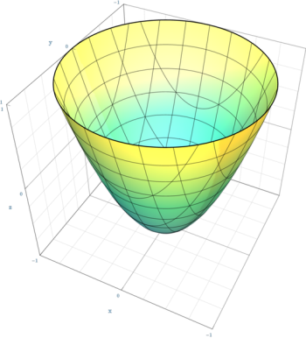
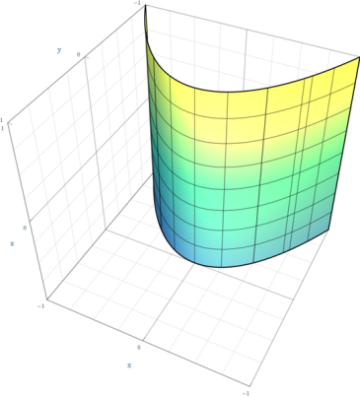
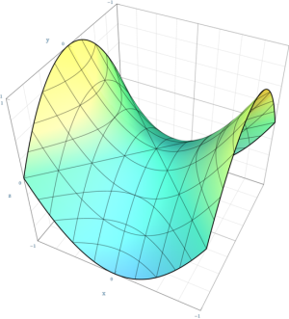
Examples for 2D functions
positive definite
indefinite
negative semi-definite
Images from Wikipedia
Notes:
Draw the axes
Say that in high dimensions, most quadric functions are indefinite.
Point out that convex function has a single minimum

Slide 28
Checking convexity using the Hessian
What is positive (semi-)definiteness?
How to check it?
Look at the eigenvalues?
Look at principal minors (positive definiteness)?
Run Cholesky (until it fails…)
Notes:
Question: is any matrix either p.s.d. or p.n.d?
How to check?
Eigenvalues, Cholesky, leading principal minors

Slide 29
Convexity quiz 2

Slide 30
Composition rules
When is f(g(x)) convex?
Sufficient condition 1: f is convex and non-decreasing, g is convex.
Sufficient condition 2: f is convex and non-increasing, g is concave.
Note: no sorts of converse statements are true, e.g.

Slide 31
All minima of convex function are global
Proof: Assume x is a local minimum and is not a global minimum:
R
x
y

Slide 32
Convex programming
Convex objective
“minimize”
“subject to”
Convex domain
Corollary: any local optimum is global
Proof: see previous slide

Slide 33
Linear program

Slide 34
Sublevel sets
Sublevel set:
Corollary: if f is convex then all sublevel sets are convex.
Is the opposite true?

Slide 35
Quasiconvex functions
Definition: the function is quasiconvex if all sublevel sets are convex.
Non-trivial example: length(x) = max_{i} [x_{i} ≠ 0]

Slide 36
Solving quasiconvex problems
Solution: “bisection” over t

